Slide 1
Research and Publication Ethics:
The Publication Process
Umang Bhaskar
March 2026

Slide 2
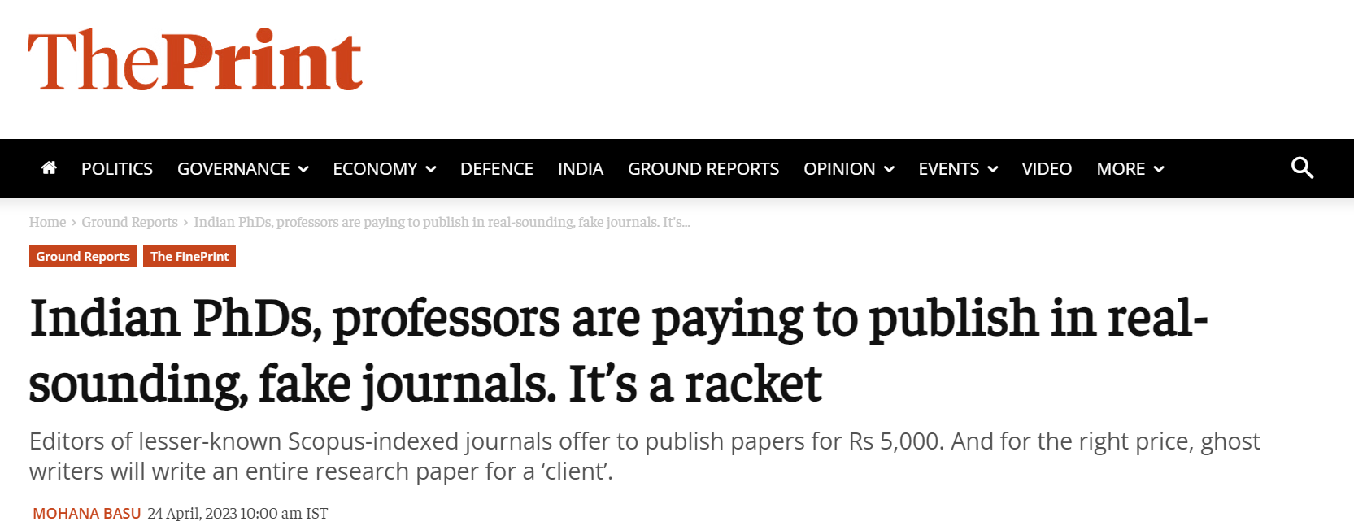
Why are we here

Slide 3
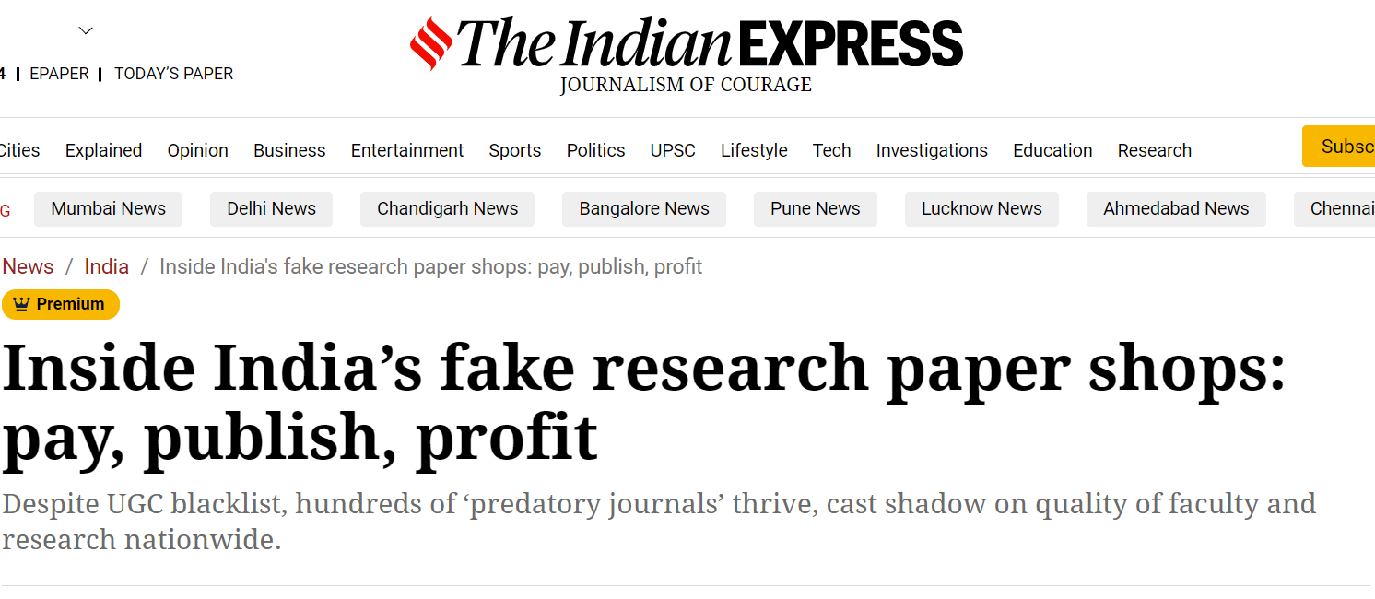
Why are we here

Slide 4
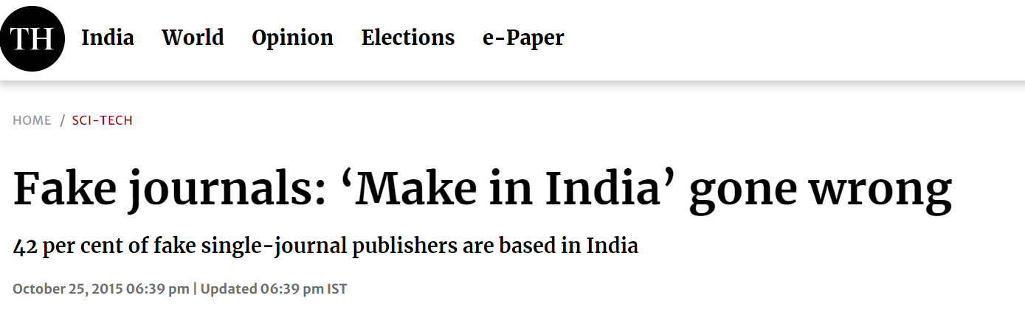
Why are we here

Slide 5
Why are we here
https://en.m.wikipedia.org/wiki/Scientific_plagiarism_in_India
UGC in 2016 mandated at least one paper for a PhD, then backtracked
But the problem continues...

Slide 6
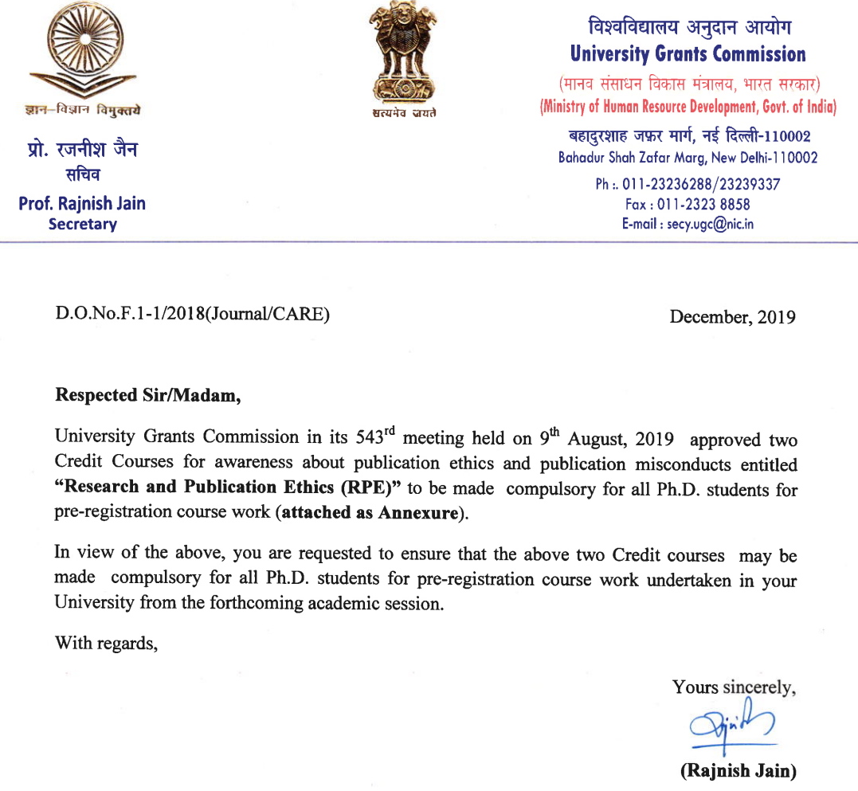
In response...

Slide 7
In response...
Blog: Can standardised courses in research ethics prevent publication misconduct?
India Retraction Watch
Question: Can ethics be taught in a classroom?

Slide 8
Summary: When in doubt, read the guidelines
UGC guidelines
TIFR guidelines
Journal / conference guidelines

Slide 9
The Publishing Ecosphere

Slide 10
Publications: Societies and publishers
ACM: STOC, EC, SIGMETRICS, JACM, TALG, ToCT, ...
SIAM: SODA, J Comput, J Disc Math, ...
IEEE: FOCS, CDC, ToN, ...
Elsevier: JCSS, TCS, ...
Springer: Algorithmics, AAMAS, ...
IARCS: FSTTCS
Others: JMLR, Comp Complexit Foundation, IJCAI, Theoretics, ...

Slide 11
Scientific publishing is a massive industry
"Elsevier, Springer Nature, Wiley and Taylor & Francis ... collectively generated over US$7.1 billion in revenue from journal publishing in 2024 alone, and over US$14 billion in profits between 2019 and 2024 ... Their profit margins have always been over 30% in the last five years ...”
(from “The Drain of Scientific Publishing” v2, https://arxiv.org/pdf/2511.04820 )

Slide 12
Publications
Journals, conferences, preprint repositories...
What is the culture in your research group?
Advantage of one vs the other?
Who owns your paper once it’s published?
JACM guidelines, author rights
What is Open Access?
Some open access journals

Slide 13
Predatory journals
Will publish any article for payment (how is this different from open access?)
Can you tell the difference?

Slide 14
Predatory journals
Beall’s list
“Within a few years, the list gained prominence and traction among scholars. By the end of 2016, it listed over 900 journals. In early 2017, Beall deleted his blog and the list, following complaints and threats of legal action from publishers. An archived version of the list still exists online.”
(from: https://paperpile.com/g/predatory-journals/)

Slide 15
Good and Bad Publications

Slide 16
Publications: Good and bad
FFP: fabrication, falsification, plagiarism
Question: What would this mean for a theoretical paper?

Slide 17
Publications: Good and bad
What does a good publication look like?
Complete proofs!
Give context, describe related work
Acknowledge ideas from other sources
Understandable in the venue it is published
Question: What else makes a good publication?

Slide 18
Publications: Good and bad
What does a bad publication look like?
Incomplete proofs, reference to non-existent “full version”
No context; assume reader is already familiar with existing work
Use of ideas from other sources without acknowledgement
Paper consists of 26 lemmas and 15 claims without any intuition or proof outline...
Question: What else makes a bad publication?

Slide 19
Publications: Authorship
Who are the “authors” of a paper?
ACM policy on authorship
IEEE policy

Slide 20
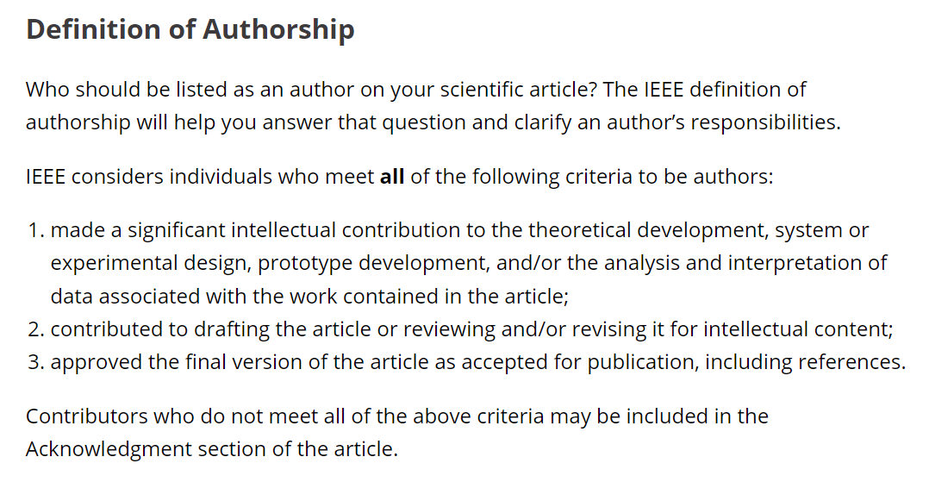
Publications: Authorship
From the IEEE policy:

Slide 21
Publications: Authorship
Still very vague...
What is a “significant conceptual contribution”?
What if you contributed the question, but nothing else?
What if you were present in meetings, but couldn’t contribute much?
What if you were present in meetings, came up with ideas, but the ideas didn’t make it to the paper?

Slide 22
What problems can I work on?
Example 1: At a conference student ABC tells you about a problem he is working on. After the conference, can you work on this separately?
Example 2: You’re visiting Professor X at IITXYZ, and she tells you about a problem she is working on with her students. After returning, can you work on this separately?
Example 3: For your PhD, you worked with your advisor on a problem that you partly completed for your thesis. After graduating can you work on this separately?

Slide 23
What if there’s an error?
What if there’s a mistake in my paper?
Retract the paper?
Ignore it?
Acknowledge on your webpage?
Question: What would you do if your paper has an error?

Slide 24
Plagiarism

Slide 25
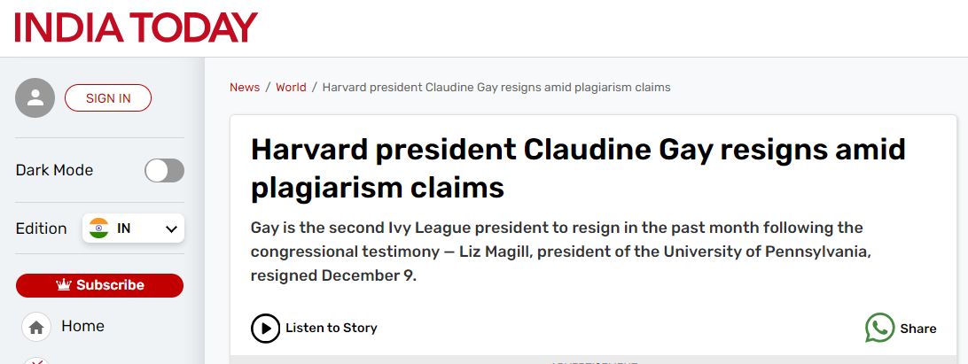
Plagiarism: Real-world examples

Slide 26
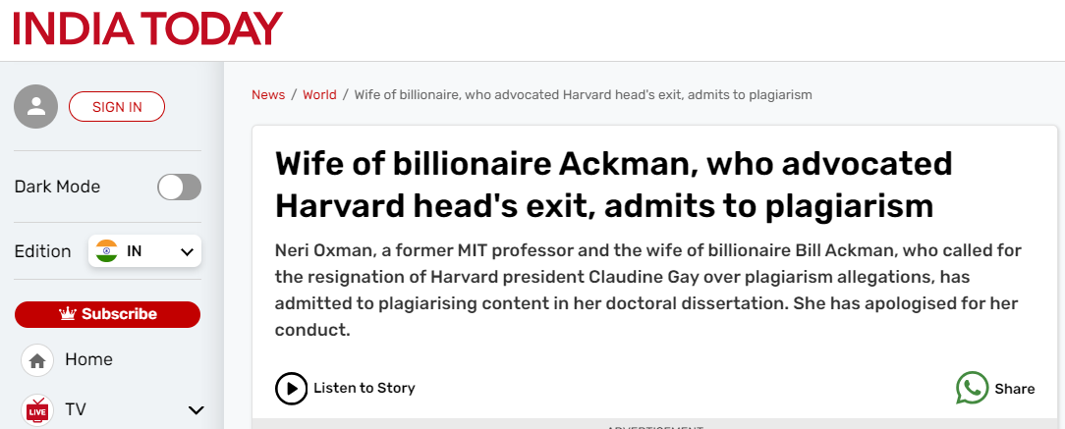
Plagiarism: Real-world examples

Slide 27
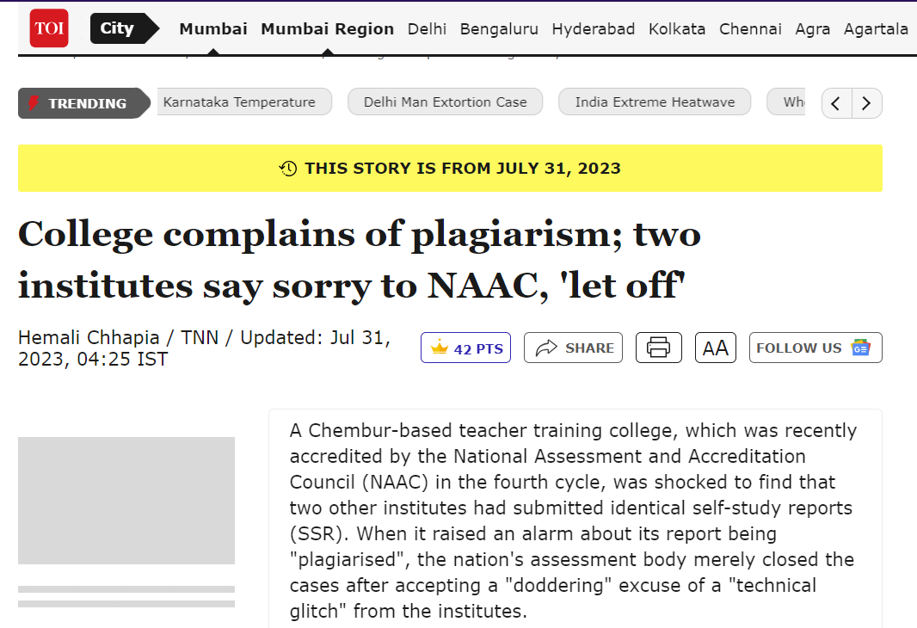
Plagiarism: Real-world examples

Slide 28
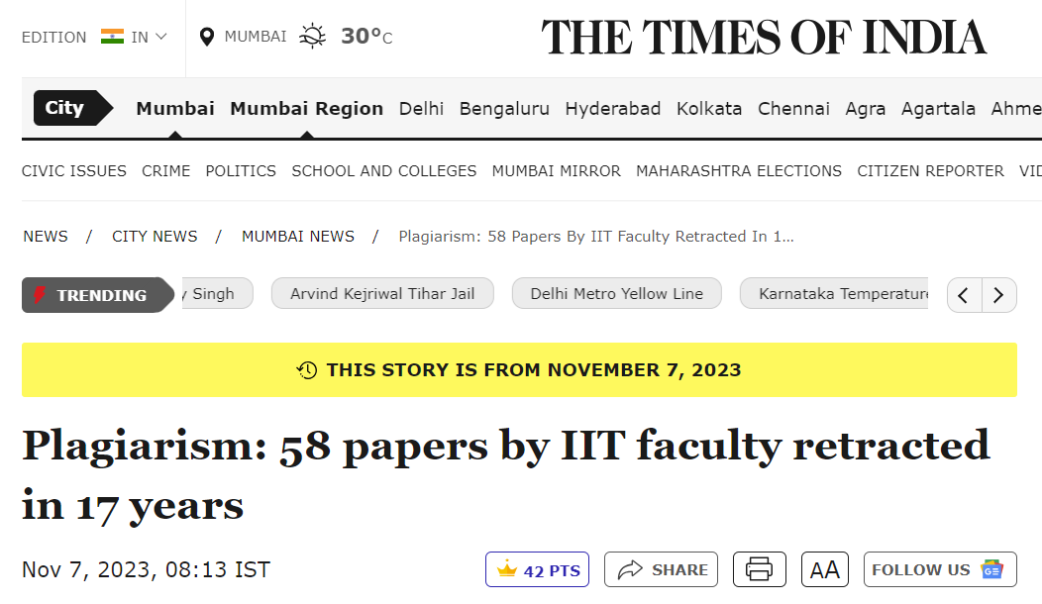
Plagiarism: Real-world examples

Slide 29
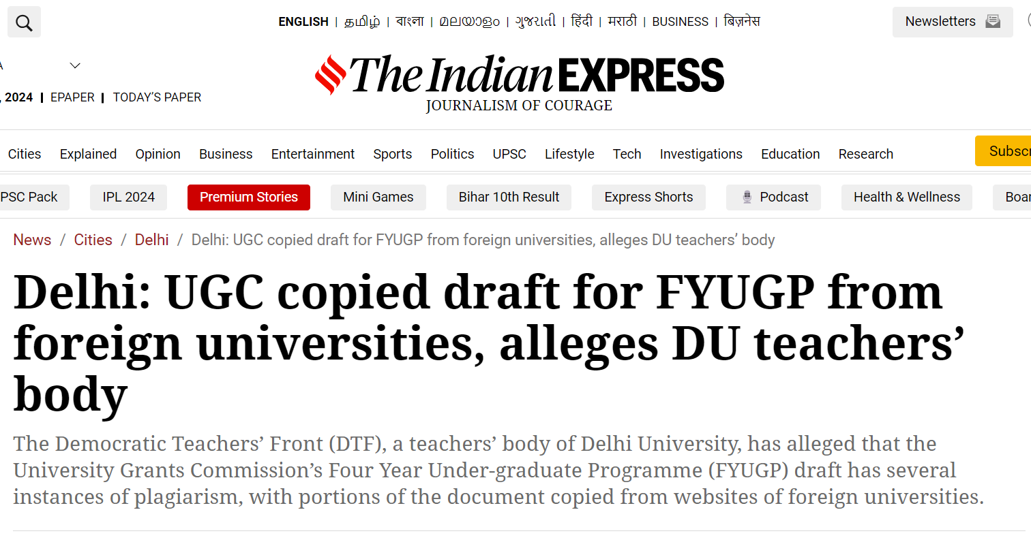
Plagiarism: Real-world examples

Slide 30
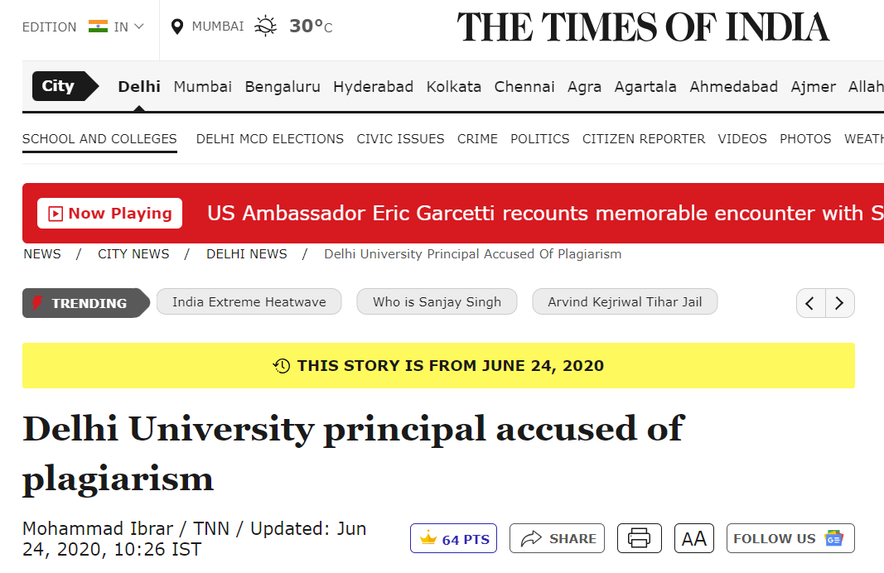
Plagiarism: Real-world examples

Slide 31
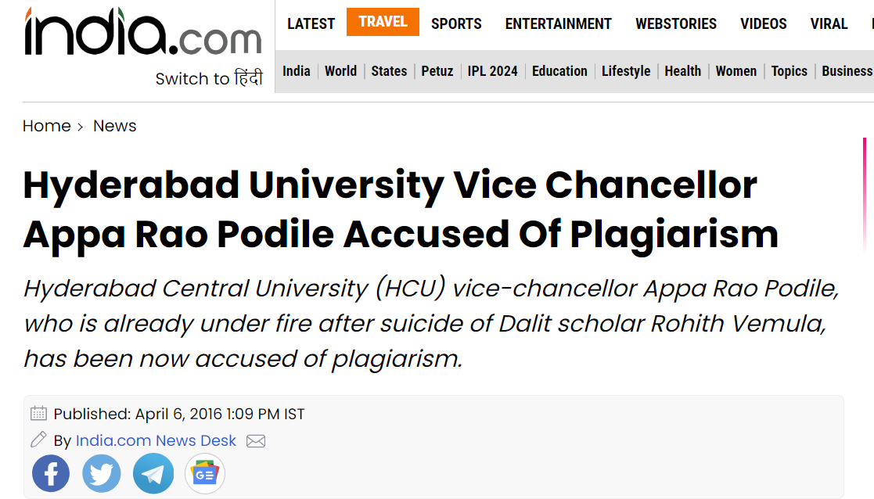
Plagiarism: Real-world examples

Slide 32
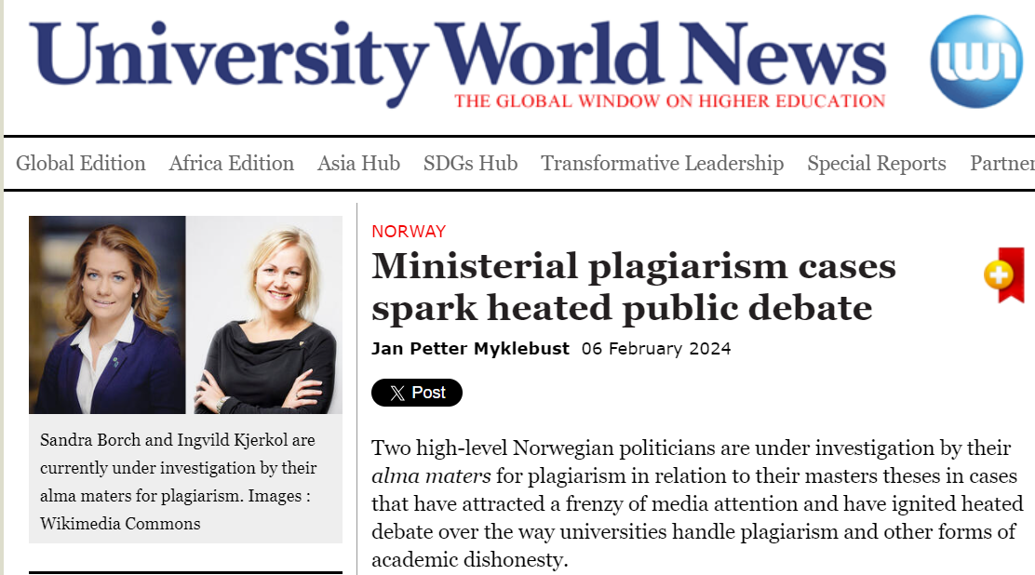
Plagiarism: Real-world examples

Slide 33
Plagiarism
many, many more such examples from around the world
Remember that anything on the internet potentially lives forever
UGC guidelines
TIFR guidelines on academic ethics

Slide 34
Plagiarism: TIFR (UGC) guidelines
Email from Dean GS (text file)
Use of Ithenticate
Other plagiarism checkers: Turnitin, Urkund, ...

Slide 35
Plagiarism: What is it?
From Oxford University (here, emphasis added):
“Presenting work or ideas from another source as your own, with or without consent of the original author ... without full acknowledgement.
All published and unpublished material ... is covered under this definition, as is the use of material generated wholly or in part through use of artificial intelligence (save when use of AI for assessment has received prior authorisation e.g. as a reasonable adjustment for a student’s disability). Plagiarism can also include re-using your own work without citation.”

Slide 36
Plagiarism: Avoidance
Always cite somebody else’s work, published or unpublished, public or private.
Always cite your own publicly available work
Always write from scratch. While writing, don’t look at other sources (h/t Piyush)
Not even your own work! (see UGC guidelines)
Just don’t use Ctrl-c Ctrl-v (or copy from a physical source, such as a book)

Slide 37
Plagiarism: Avoidance
If you absolutely have to copy from somewhere, put it in quotes and / or cite it properly.
Be very clear what is your contribution
Be generous with credit

Slide 38
Good citations
APA citation guide
Personal communication example
Unpublished manuscript example
Folklore example

Slide 39
Plagiarism: Some questions
What about standard definitions (e.g., defining Nash equilibrium)?
Can you copy someone else’s work (e.g., definitions), as long as you cite it?
What about if you put it in quotes?
What about survey articles?
What about code?

Slide 40
Plagiarism in other places
What about other creative works, apart from published papers and your thesis:
Grant proposals?
Presentations (an example)?
Popular writing (e.g., a press article, or for science communication?)
Class assignments and exams?

Slide 41
What about AI?

Slide 42
Can I use AI?
My opinion: don’t use AI. Be wary of using AI.
You will be found out
AI hallucinates frequently
Often cannot do simple tasks
Information given to AI may not remain private

Slide 43
Can I use AI?
Text entered into AI tools is not private. So you cannot use it to review a paper / manuscript.
Examples:
IJCAI: can use generative AI, but you assume all responsibility
AAAI: can’t use text generated by AI
JMLR: can use, but you assume all responsibility, and acknowledge

Slide 44
Peer Reviewing

Slide 45
The review process
You will receive an invitation to review (either a single paper, or multiple papers for a conference) The invitation (or CFP) will state the deadline and process (double-blind, paper length, rebuttals, discussions, etc.)
You accept or reject
You will get the paper(s) to review, with a deadline (possibly after bidding)
Submit your independent review
You may then discuss the paper with other reviewers, or receive author feedback, based on which you modify your review
Final acceptance / rejection depends on the editor, or after PC discussions.

Slide 46
What is expected of a reviewer
Have expertise in the subject of the paper (mostly...)
Read and understand the main body of the paper
Critically evaluate strengths and weaknesses of the paper
What is the main contribution?
Is the contribution significant enough for publication?
Is it written clearly?
Does it review relevant literature appropriately?
Suggestions for improvement?
Give opinion on acceptance / non-acceptance
Keep in mind CoI and confidentiality
Be on time, respect the process

Slide 47
What isn’t expected of a reviewer
Read and understand everything in the paper, including appendices (though you should try to)
Be responsible for technical correctness
Point out all errors and typos

Slide 48
A sample guide
Reviewing document for EC 2026 (link removed)
ACM peer review guidelines

Slide 49
CoI
Conflict of Interest
Don’t review a paper you would be biased about
Papers by colleagues; recent collaborators; students or advisors; postdoc supervisor; a friend or family
Not just papers, but also awards, positions, grant proposals, ...
ACM’s definition of CoI

Slide 50
Confidentiality
You cannot give the paper to others, without authorisation
You cannot discuss the paper with others
You cannot use ideas or results, or work on open problems, contained in a paper you have reviewed, until the paper is publicly available.

Slide 51
Examples from COPE
COPE = Committee On Publication Ethics
Example 1: Reviewer added as a coauthor
Example 2: Breach of review confidentiality

Slide 52
Please note
Reviewing puts you in a position of authority and power. Please use it responsibly. Remember the author(s) are human beings, who have put hard work into this submission.

Slide 53
Don’t be mean or condescending
Don’t say “this may be accepted to a lower-ranked conference / journal”
Don’t accept / reject because of typos, or language
Don’t make broad statements about entire fields
Do back up your opinions with solid reasons
E.g., why is the problem not interesting?
Do try and be constructive
Are there related problems that are more interesting?
Concrete suggestions for improving the clarity?

Slide 54
Assignments (deadline: March 20th)
1. Write about one page on some things that were new to you in this module (went against common sense, or you did not know / think about)
2. Write about one page on how you would improve this module

Slide 55
Thanks!

Slide 56
Mea Culpa
I should have cited the source of the newspaper clippings on my slides (I figured the source would be obvious, but I should still have stated the websites)

Slide 57
A sample use of ChatGPT
To generate a paper introduction
To generate a teaching statement

